Slide 1


Computational Microscopy
Tom Zimmerman
IBM Research-Almaden
Center for Cellular Construction
Nov 30, 2020
This material is based upon work supported by the NSF under Grant No. DBI-1548297.
Disclaimer: Any opinions, findings and conclusions or recommendations expressed in this material are those of the authors and do not necessarily reflect the views of the National Science Foundation.

Slide 2
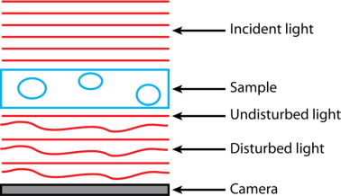
https://www.sciencedirect.com/science/article/pii/S1046202317302384

Slide 3
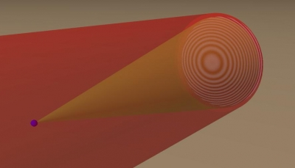
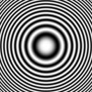
Creating Hologram of Point Object
Image Sensor
Reference Beam
Interference Pattern
LASER
Subject Beam
Subject
(point)
Z
Fresnel Zone Plate
https://github.com/manoharan-lab/holopy
Manoharan Lab, Harvard
https://holopy.readthedocs.io/en/latest/users/index.html
https://manoharan.seas.harvard.edu/holographic-microscopy

Slide 4
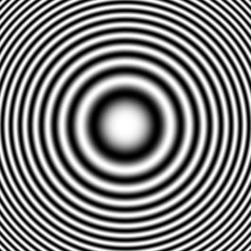
Reconstruction with Laser
Laser
Reconstructed
Subject
Photographic Film of Interference Pattern
(Fresnel Zone Plate for point source)

Slide 5
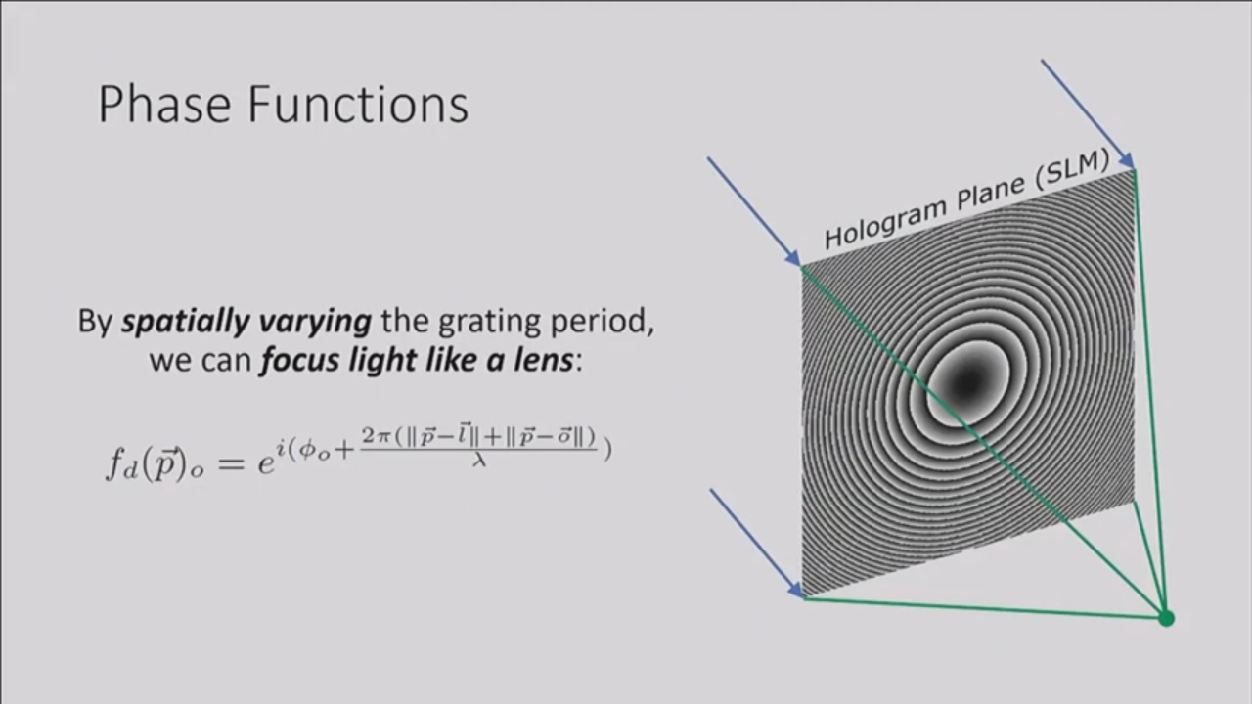
https://youtu.be/oq9UsYHyUvo

Slide 6
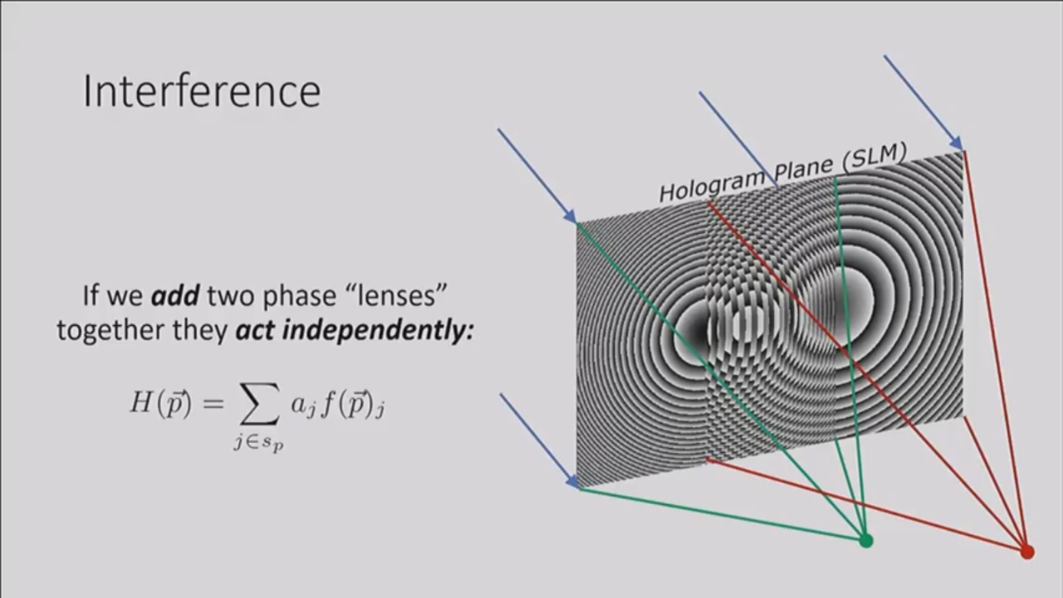
https://youtu.be/oq9UsYHyUvo

Slide 7

https://youtu.be/oq9UsYHyUvo

Slide 8
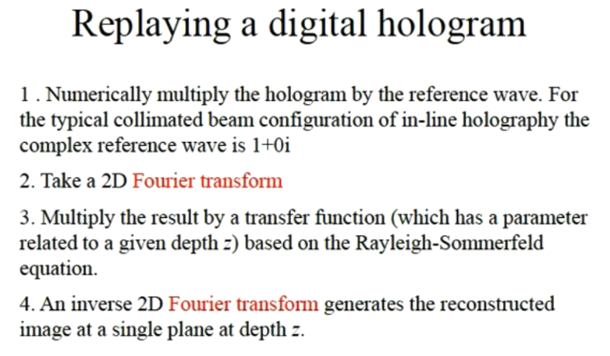
(no complex part)
# make a grid the same size of the image
M, N = input_img.shape # get image size, rows M, columns N
kx,ky = x / (dxy * N), y / (dxy * M)
kxy2 = (kx * kx) + (ky * ky)
# compute phase aberration in the grid
_ph_abbr = np.exp(-1j * np.pi * wvlen * zdist * kxy2) # Pi * wavelength * Z distance
https://youtu.be/_BzEi3PD3Y0

Slide 9

+2 -1 -2 +148 -4 +1
+2 -1 +35 +72 +35 +1
d>0
d>10
dmax>10

Slide 10
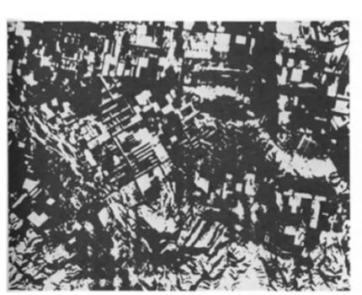
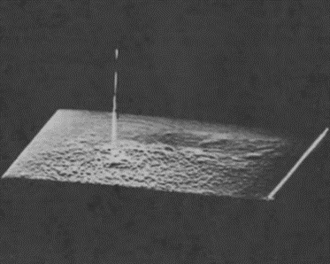
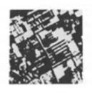
Cross-Correlation
Test Image f(x,y) Template Image h(x,y) Cross Correlation
C(i,j) = f(x,y)h(i+x,j+y)dxdy
C=F⁻¹[F{f} F{h}]
Multiplication in the Frequency Domain = Convolution in the Time Domain
Hetch, Optics
https://youtu.be/MQm6ZP1F6ms

Slide 11
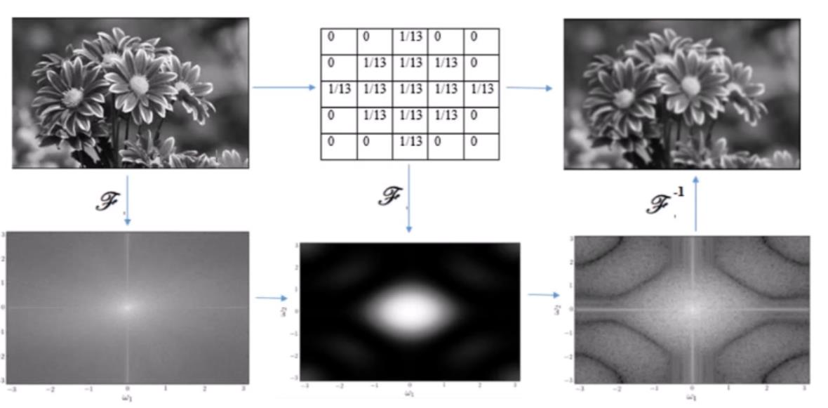
Low Pass Filtering in the Spatial and Frequency Domain
Convolution Kernel
Multiplication in the Frequency Domain = Convolution in the Time Domain

Slide 12
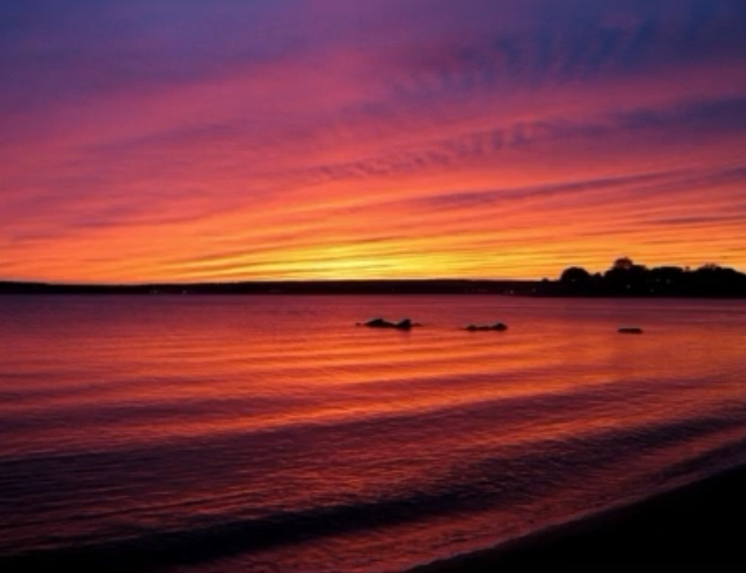
youtu.be/7mkn47hqqkc

Slide 13
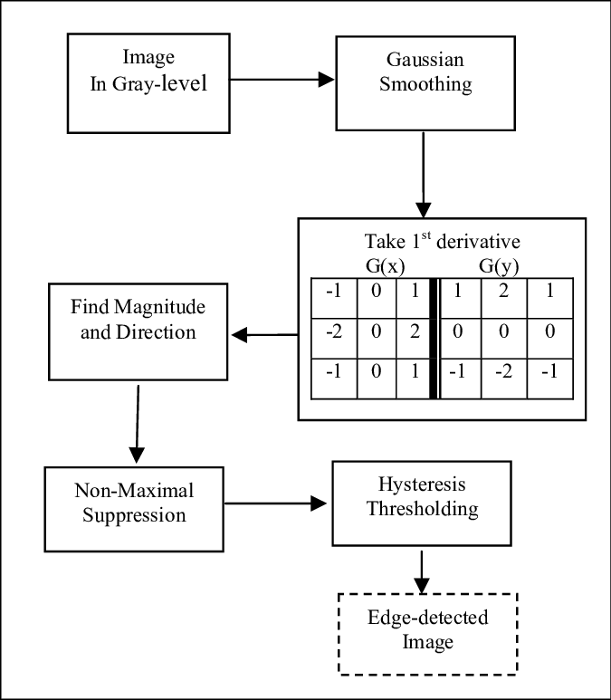
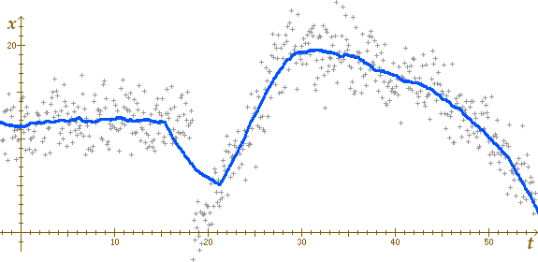
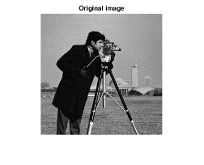

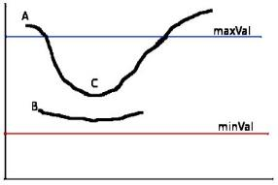
Canny Edge Detection Process
+2 -1 -2 +148 -4 +1
+2 -1 +35 +72 +35 +1
Definitely Edge
Edge only if connected to Definite Edge
Never an Edge
https://www.mathworks.com/help/images/apply-gaussian-smoothing-filters-to-images.html
An improved image processing technique for asphalt concrete X-ray CT images Jun 2013, Habtamu M. Zelelew, HM et al.

Slide 14
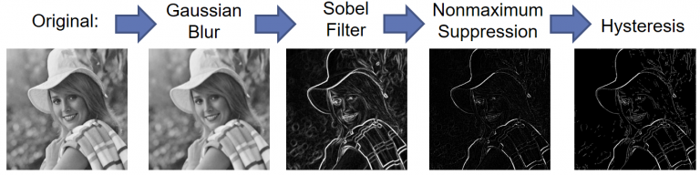
Canny Edge Detection
https://www.legupcomputing.com/blog/index.php/2017/08/25/canny-edge-detector-using-legup/

Slide 15
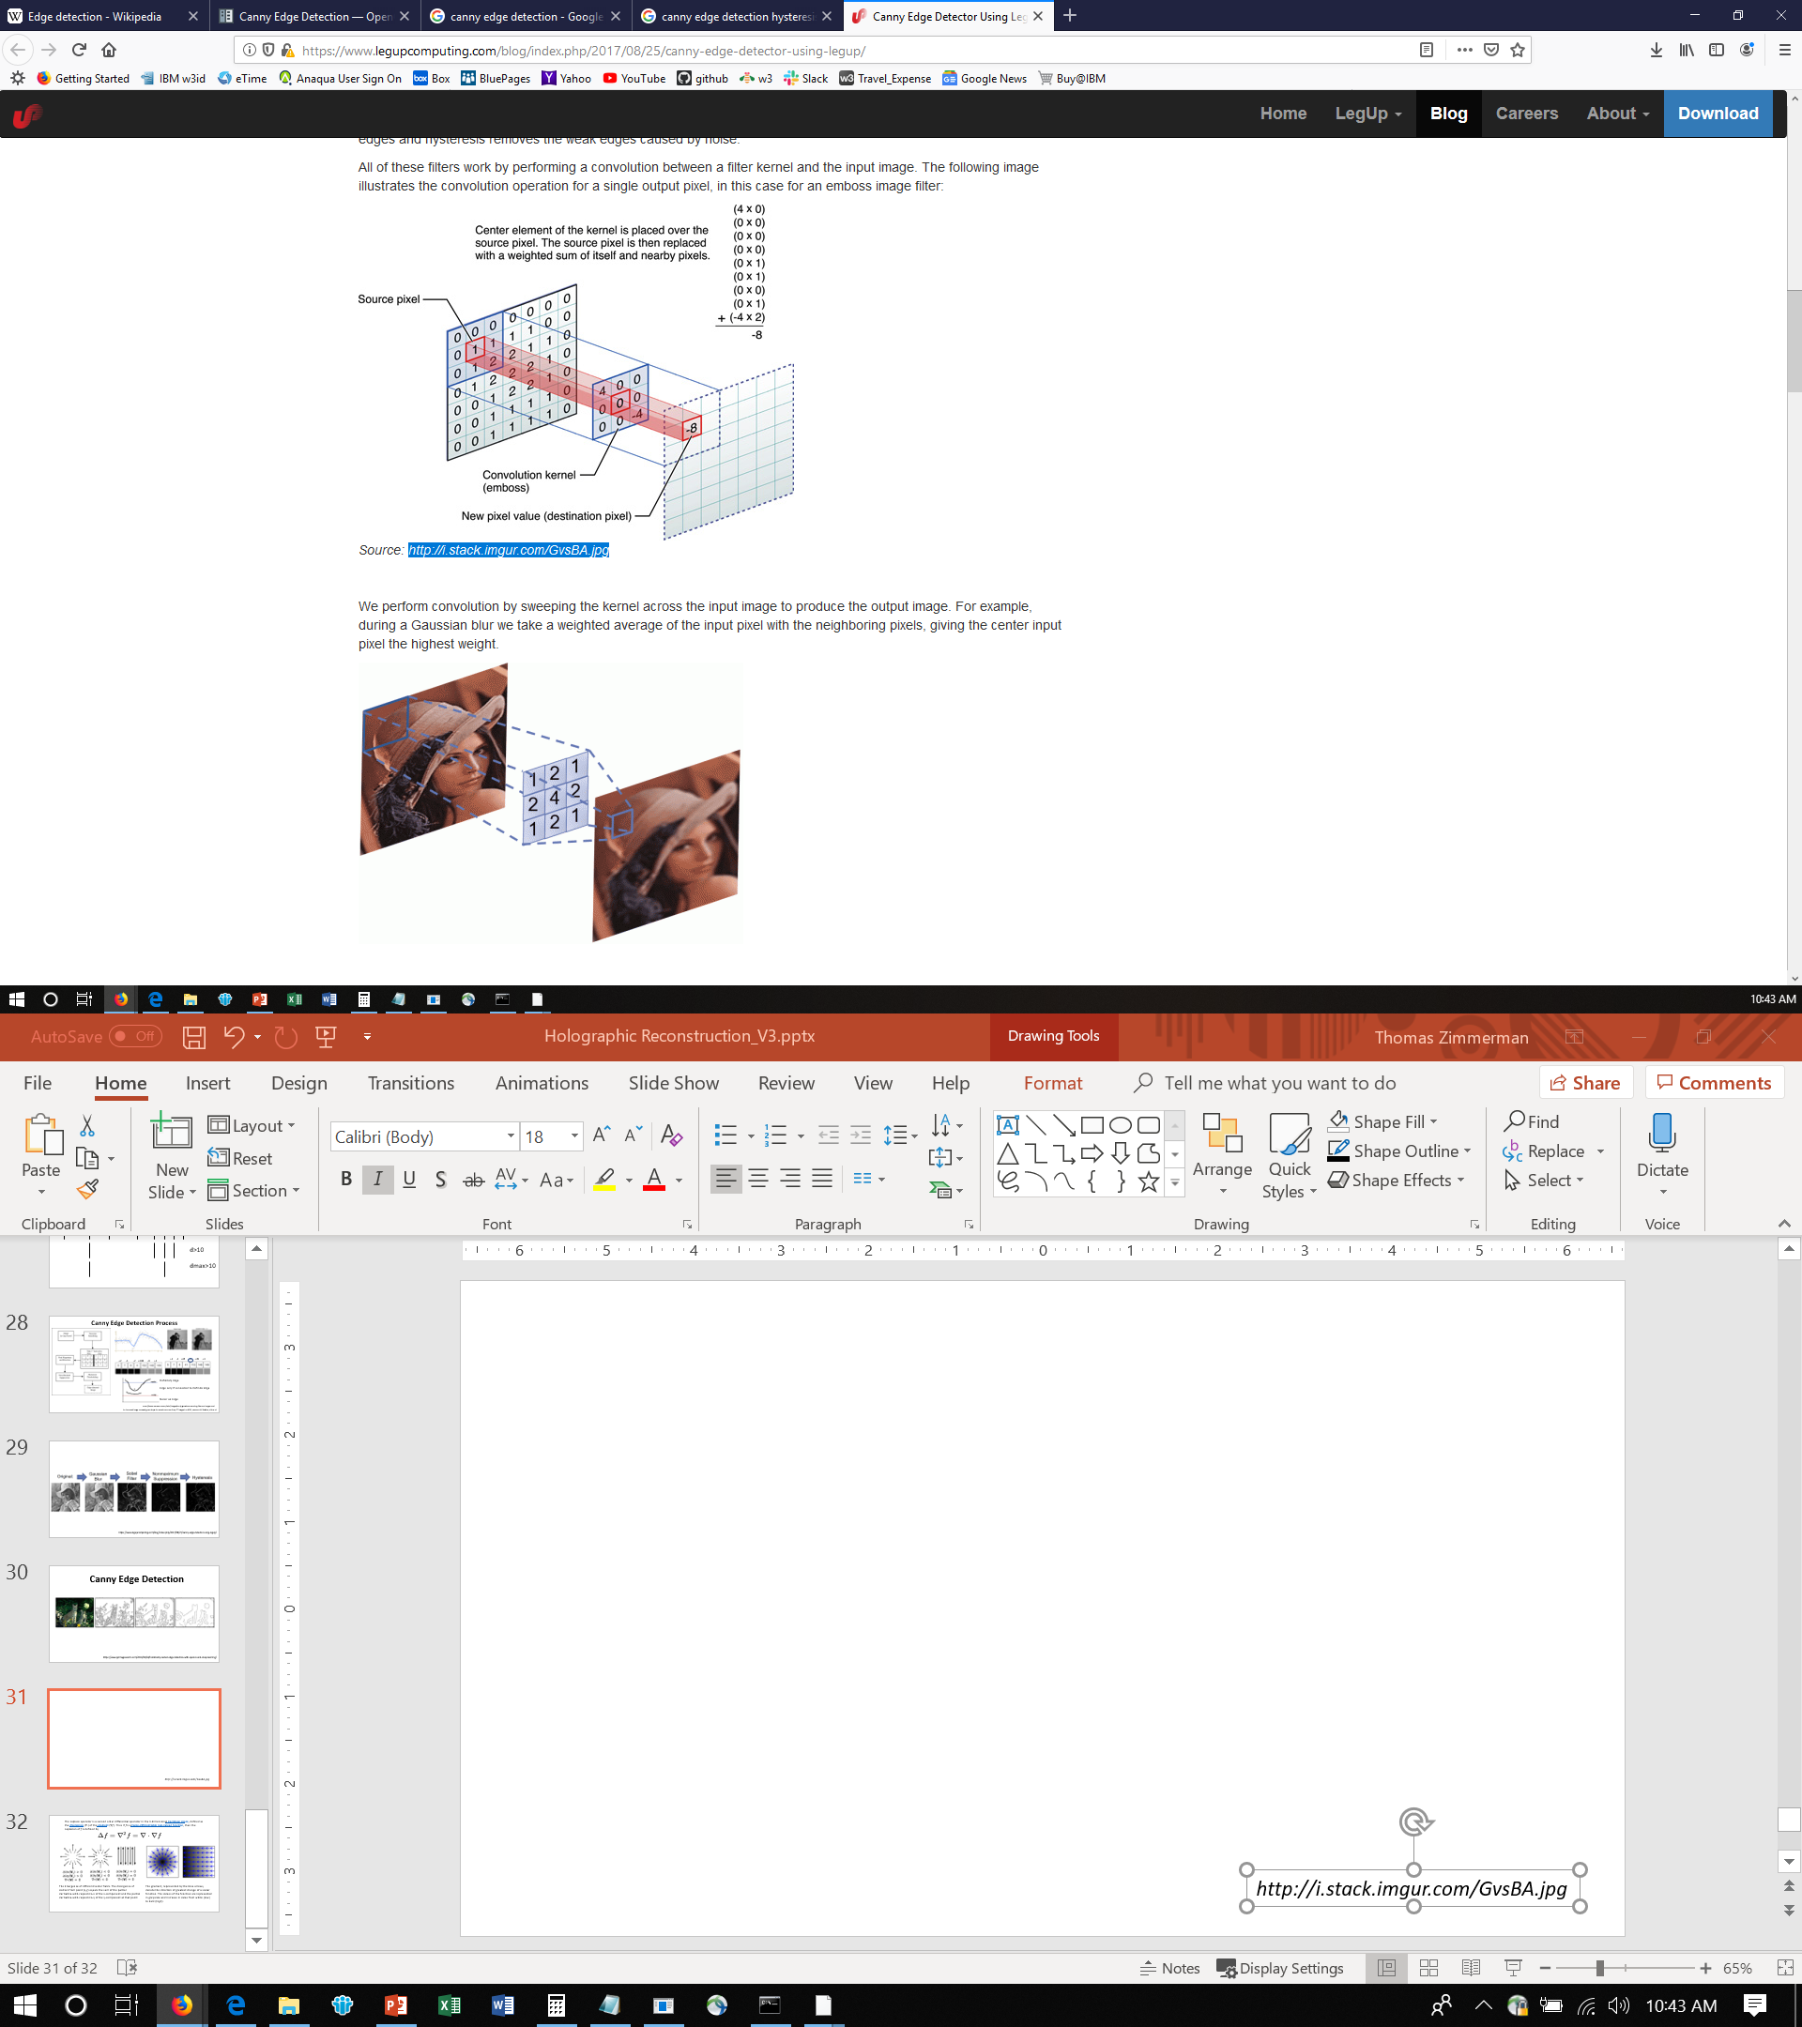
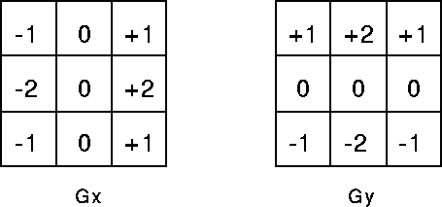
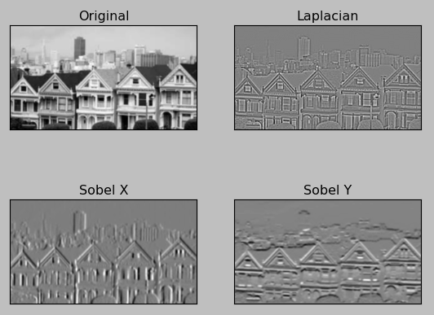
Sobel Convolution Kernels
1/16*
https://www.legupcomputing.com/blog/index.php/2017/08/25/canny-edge-detector-using-legup/
http://i.stack.imgur.com/GvsBA.jpg
Sobel Convolution Kernels https://homepages.inf.ed.ac.uk/rbf/HIPR2/sobel.htm

Slide 16
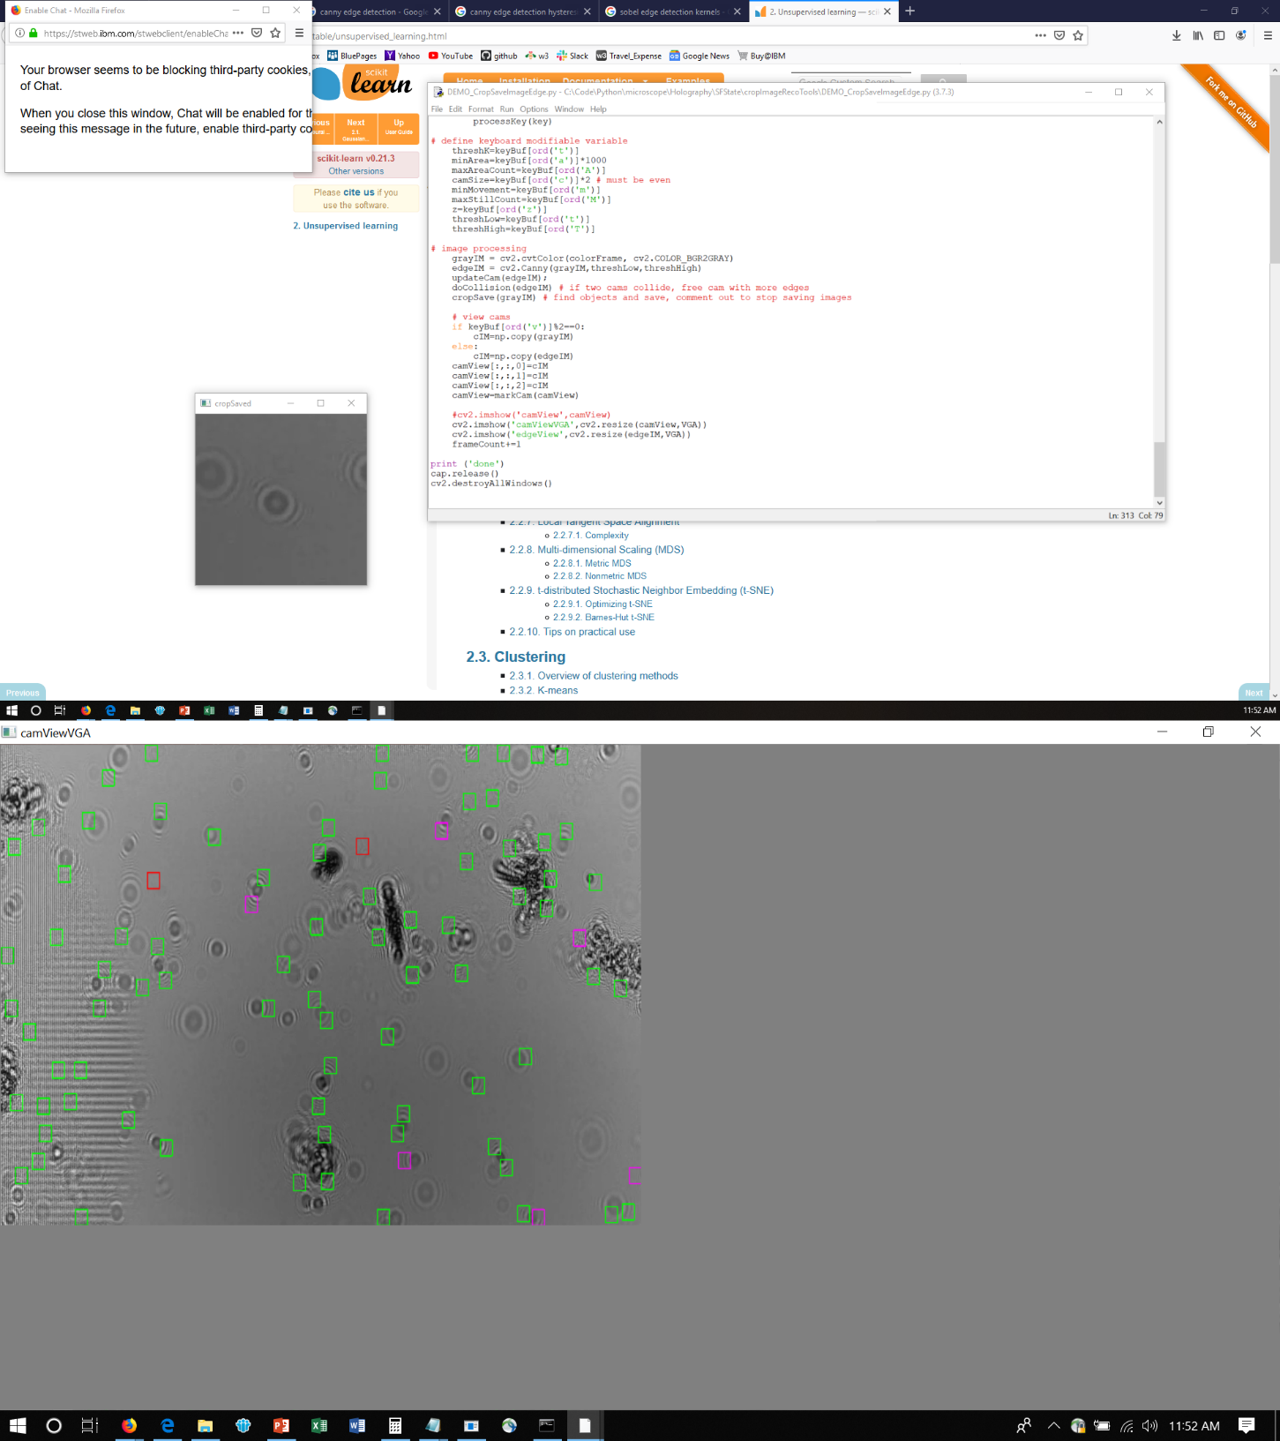
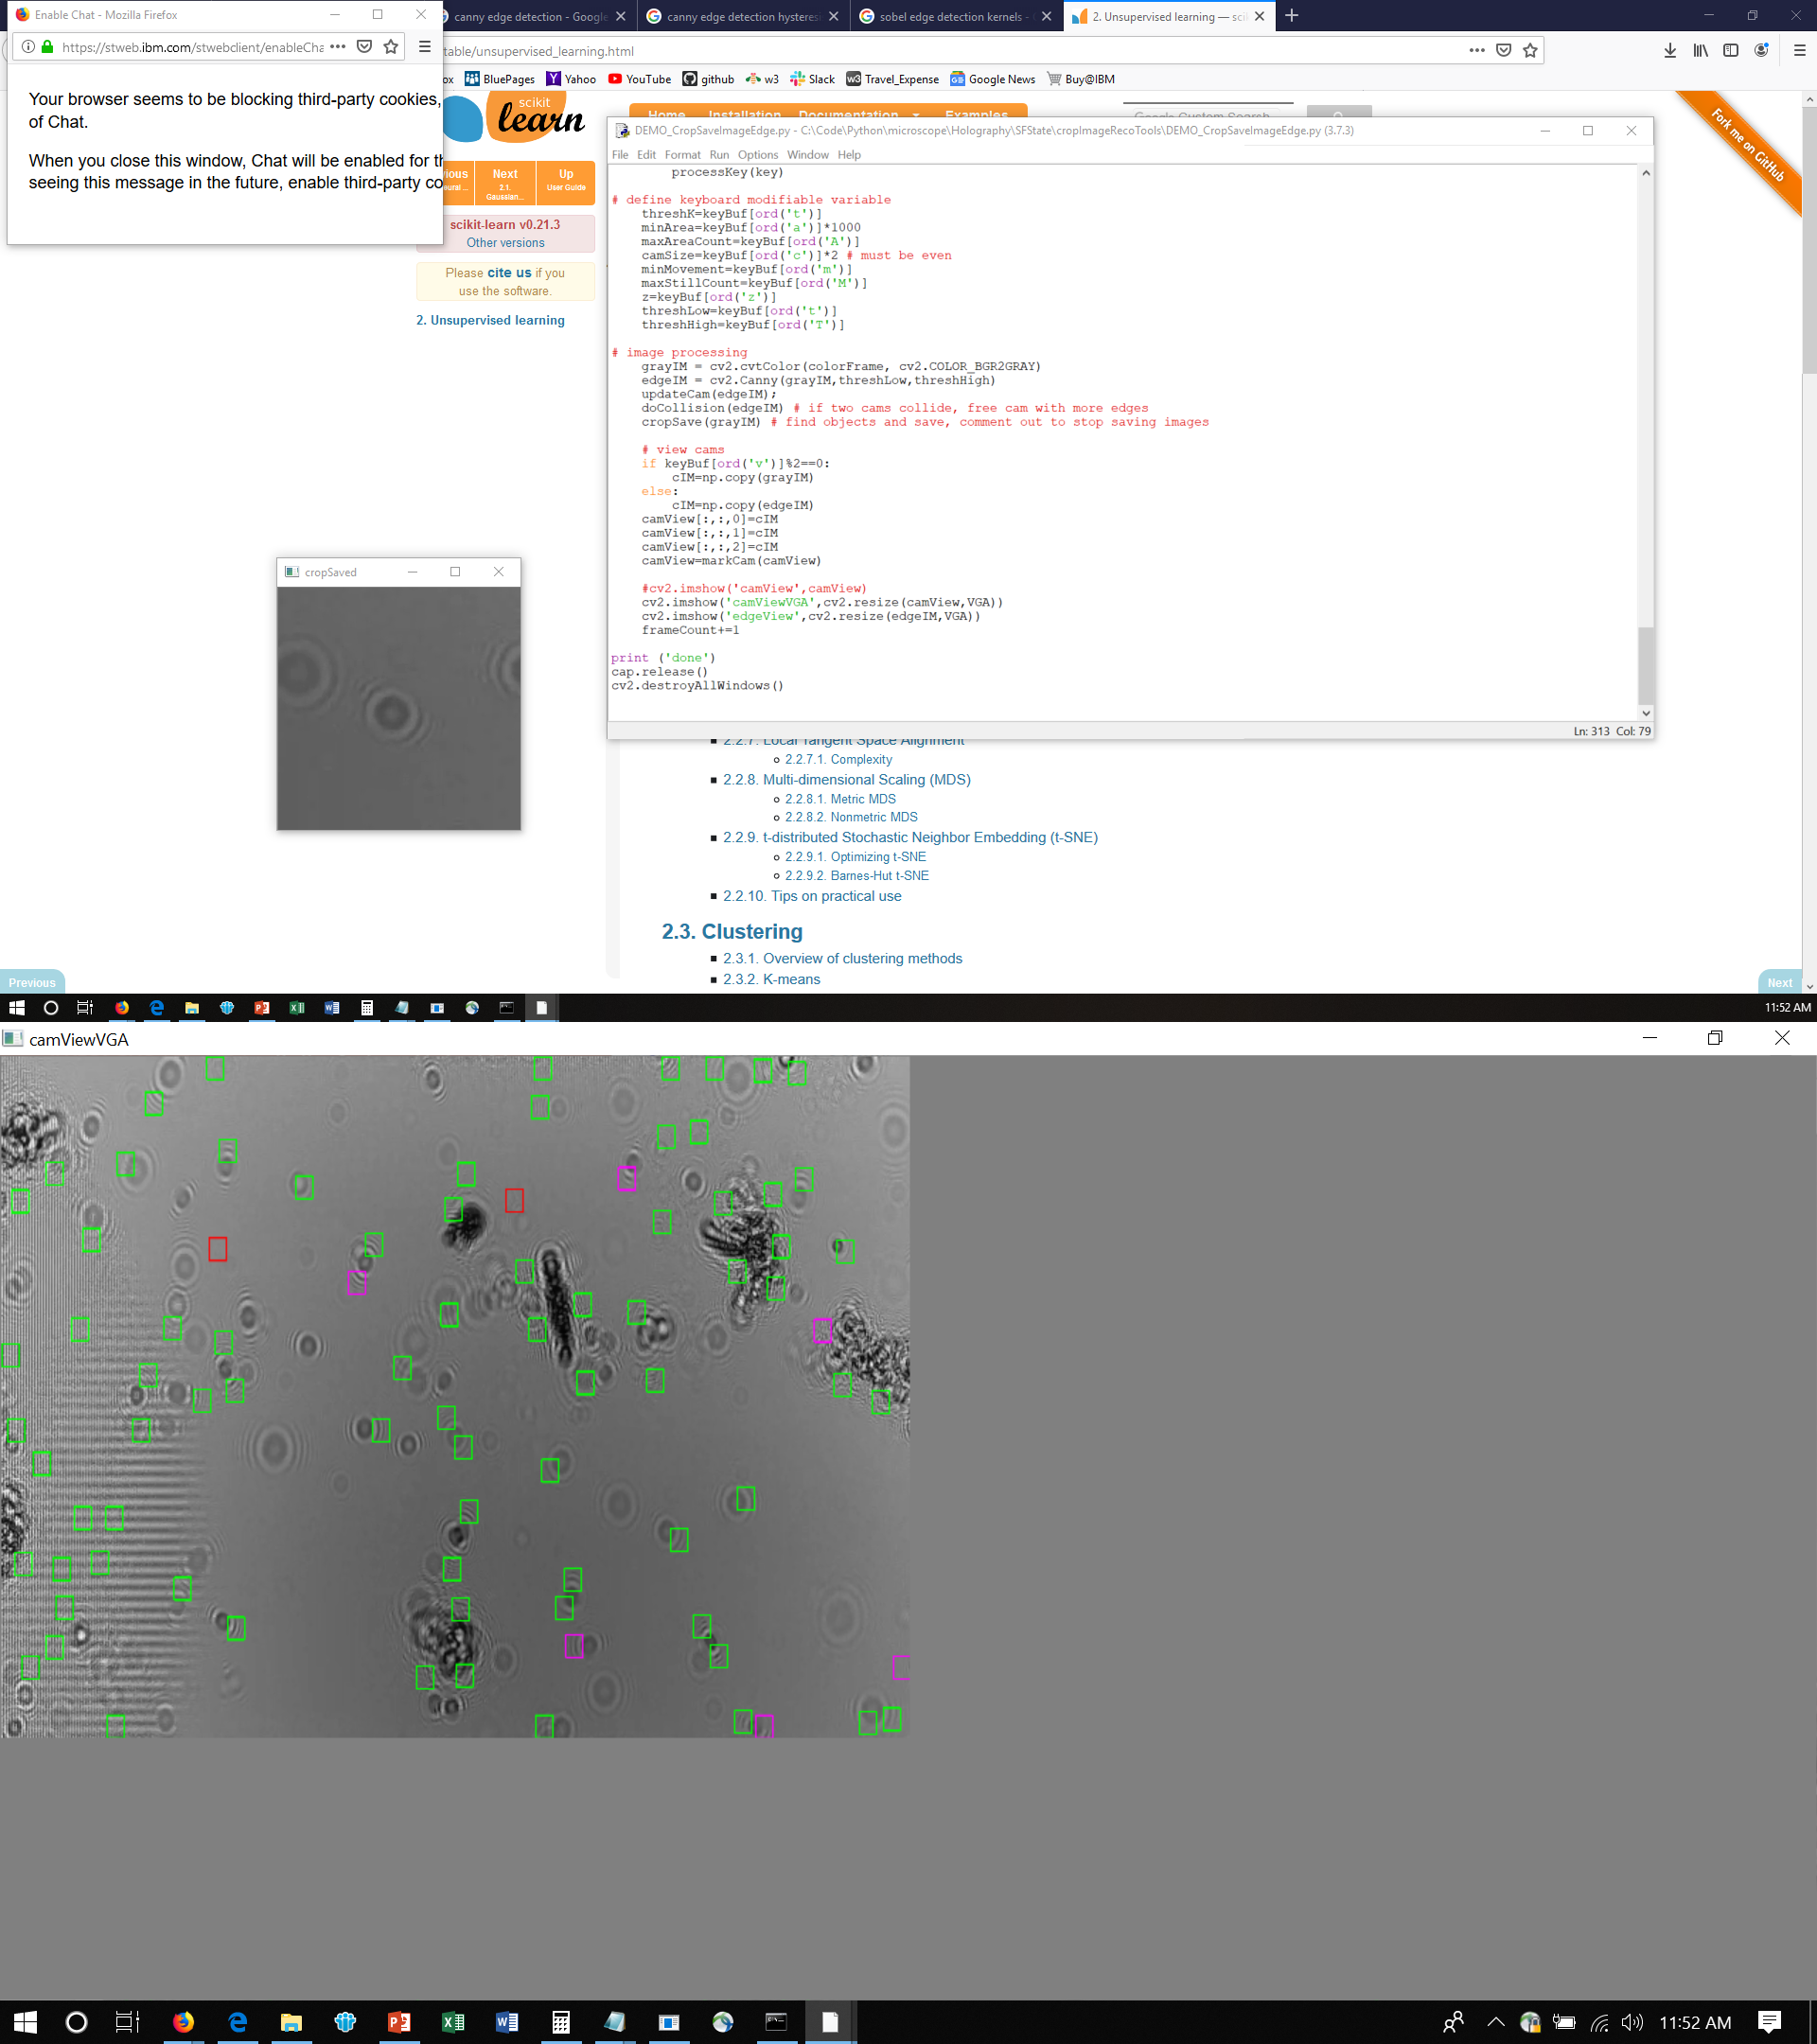
CAM TRACKING
grayIM = cv2.cvtColor(colorFrame, cv2.COLOR_BGR2GRAY)
edgeIM = cv2.Canny(grayIM,threshLow,threshHigh)
updateCam(edgeIM);
if FREE createCam (locate in random position) -> ACQUIRE
if ACQUIRE wanderCam if find something -> TRACK
if TRACK moveCenter
doCollision(edgeIM) # if two cams collide, cam with less edges TRACK->FREE
cropSave(grayIM) # find objects and save, comment out to stop saving images

Slide 17
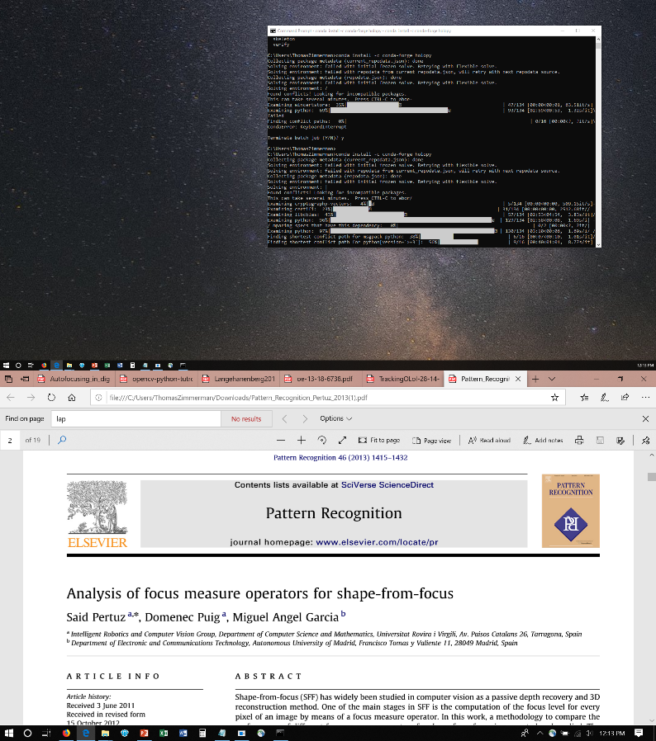
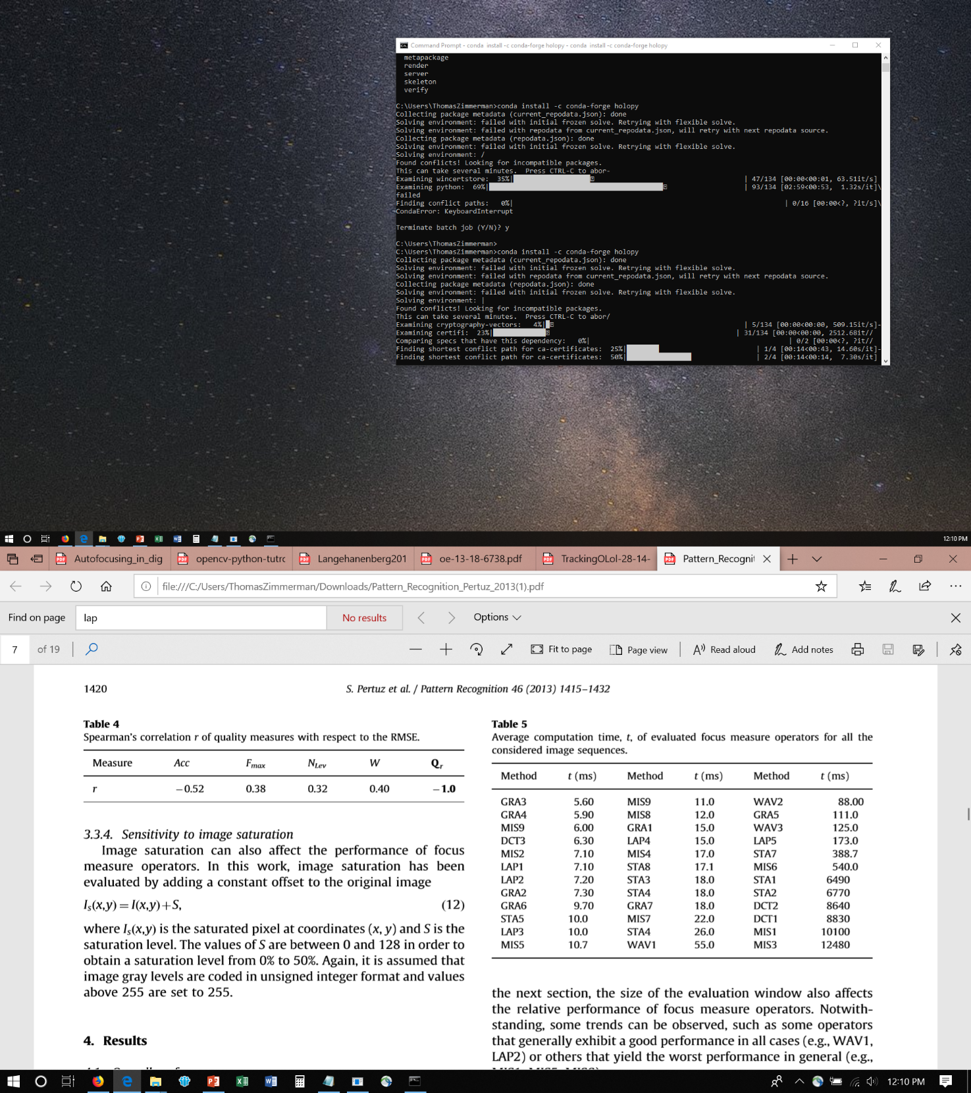
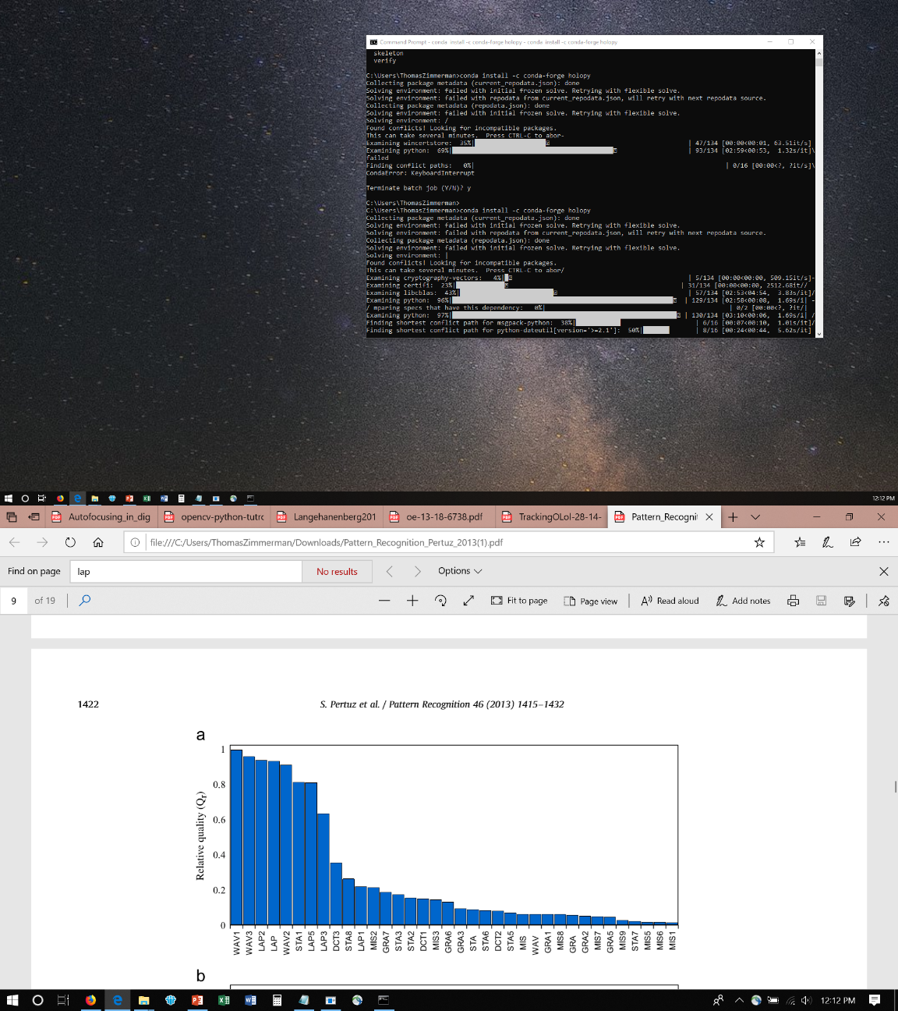

Slide 18
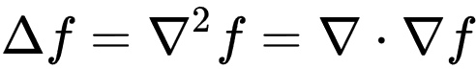
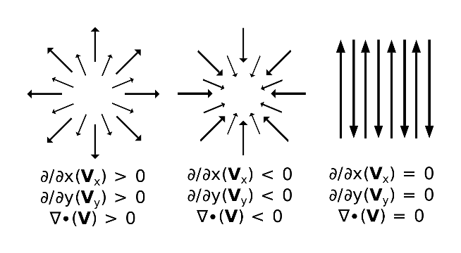
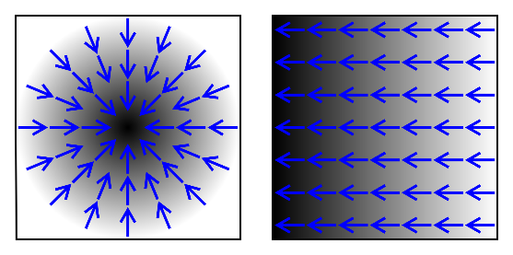
The Laplace operator is a second order differential operator in the n-dimensional Euclidean space, defined as the divergence (∇·) of the gradient (∇f ). Thus if f is a twice-differentiable real-valued function, then the Laplacian of f is defined by
The divergence of different vector fields. The divergence of vectors from point (x,y) equals the sum of the partial derivative-with-respect-to-x of the x-component and the partial derivative-with-respect-to-y of the y-component at that point:
The gradient, represented by the blue arrows, denote the direction of greatest change of a scalar function. The values of the function are represented in greyscale and increase in value from white (low) to dark (high).

Slide 19
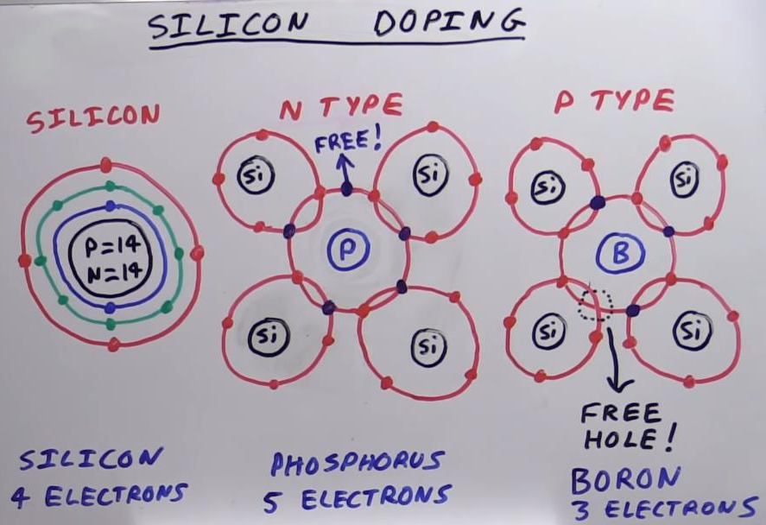

https://www.youtube.com/watch?v=qUeK7pHe0rI

Slide 20
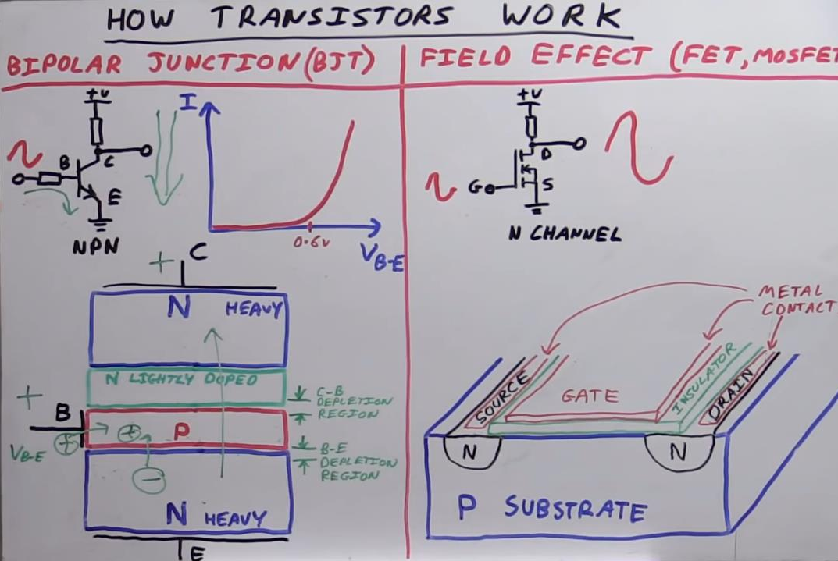

Slide 21
The pinhole diameter should be in the same range as the wavelength of the used laser light in order to derive an approximately spherical wavefront.
The sample should be small compared to the area illuminated by the point source and be positioned at a relatively short, yet suﬃcient distance from the pinhole. Most suitable is a distance of a factor 10^3 to 10^4 larger than the wavelength. Thus, the condition for Fraunhofer diﬀraction a^2<<dλ is met, where a is the dimension of the sample, d the distance between pinhole and sample and λ the wavelength of the illuminating light. Additionally, the smallest possible distance d provides for the highest possible magniﬁcation ν, as the intercept theorem supplies ν = L/d, L being the distance from the detector to the pinhole.
Λ=650 nm, d=10 mm a=100 um dλ =
ν = L/d L=15 mm

Slide 22
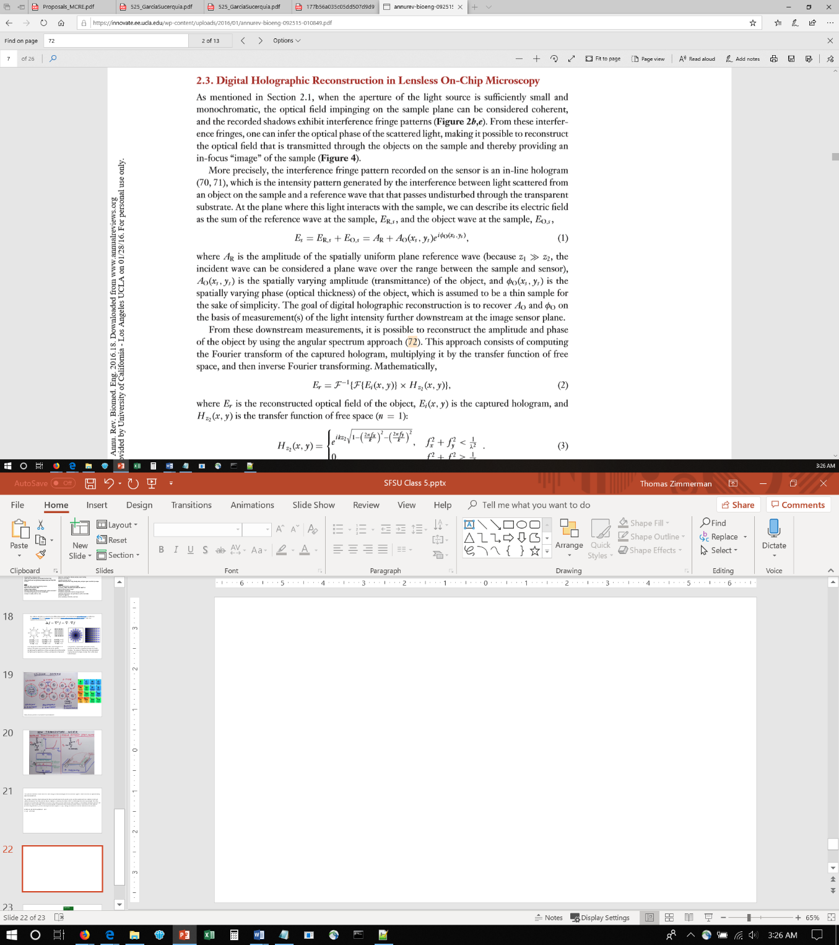
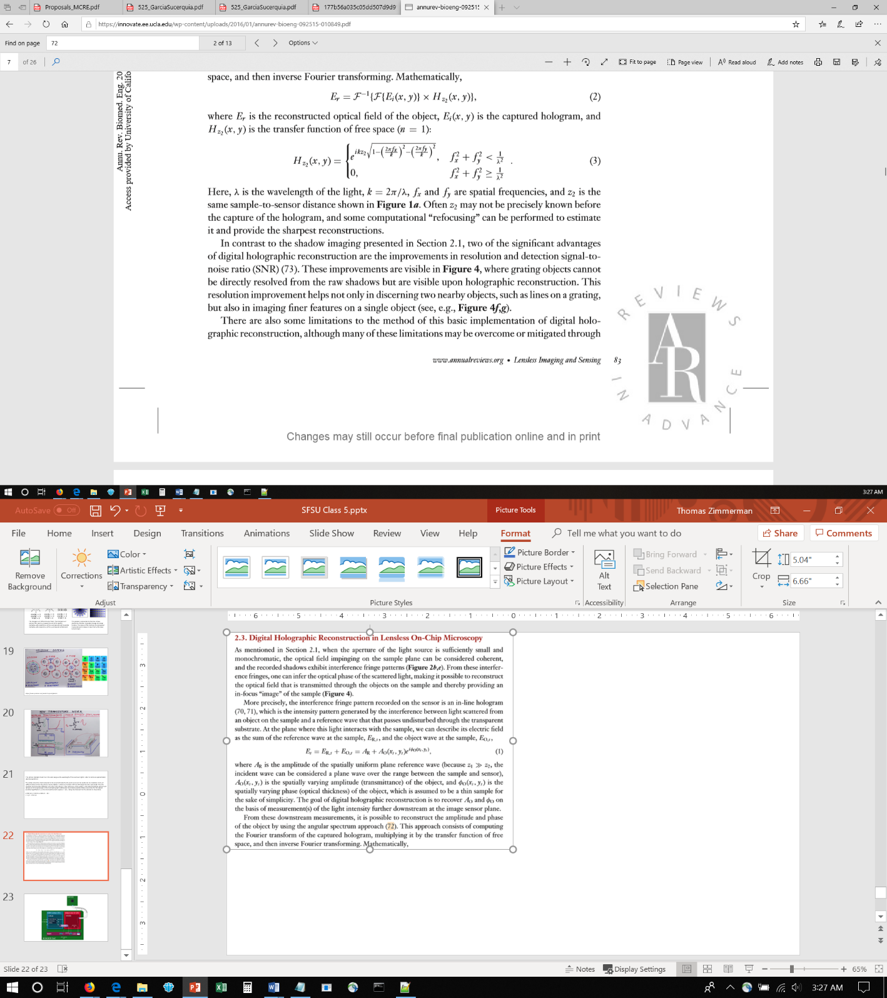
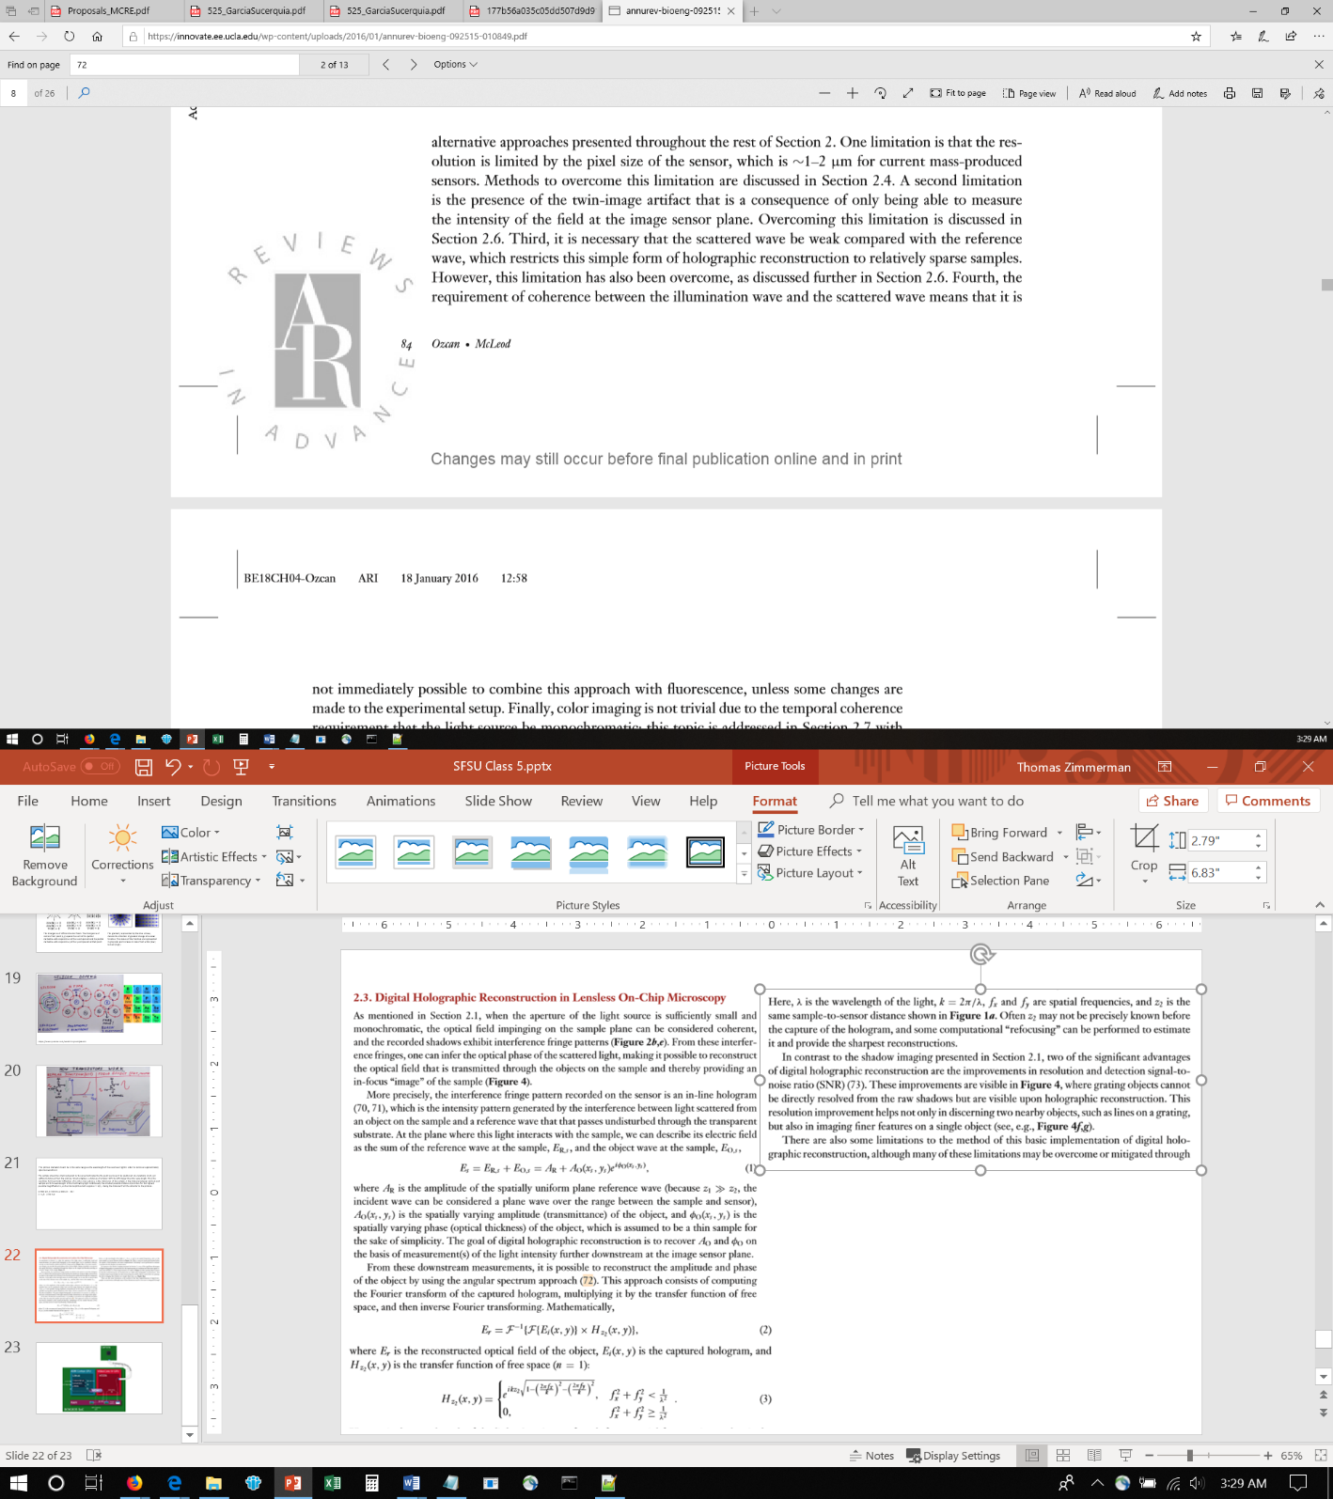
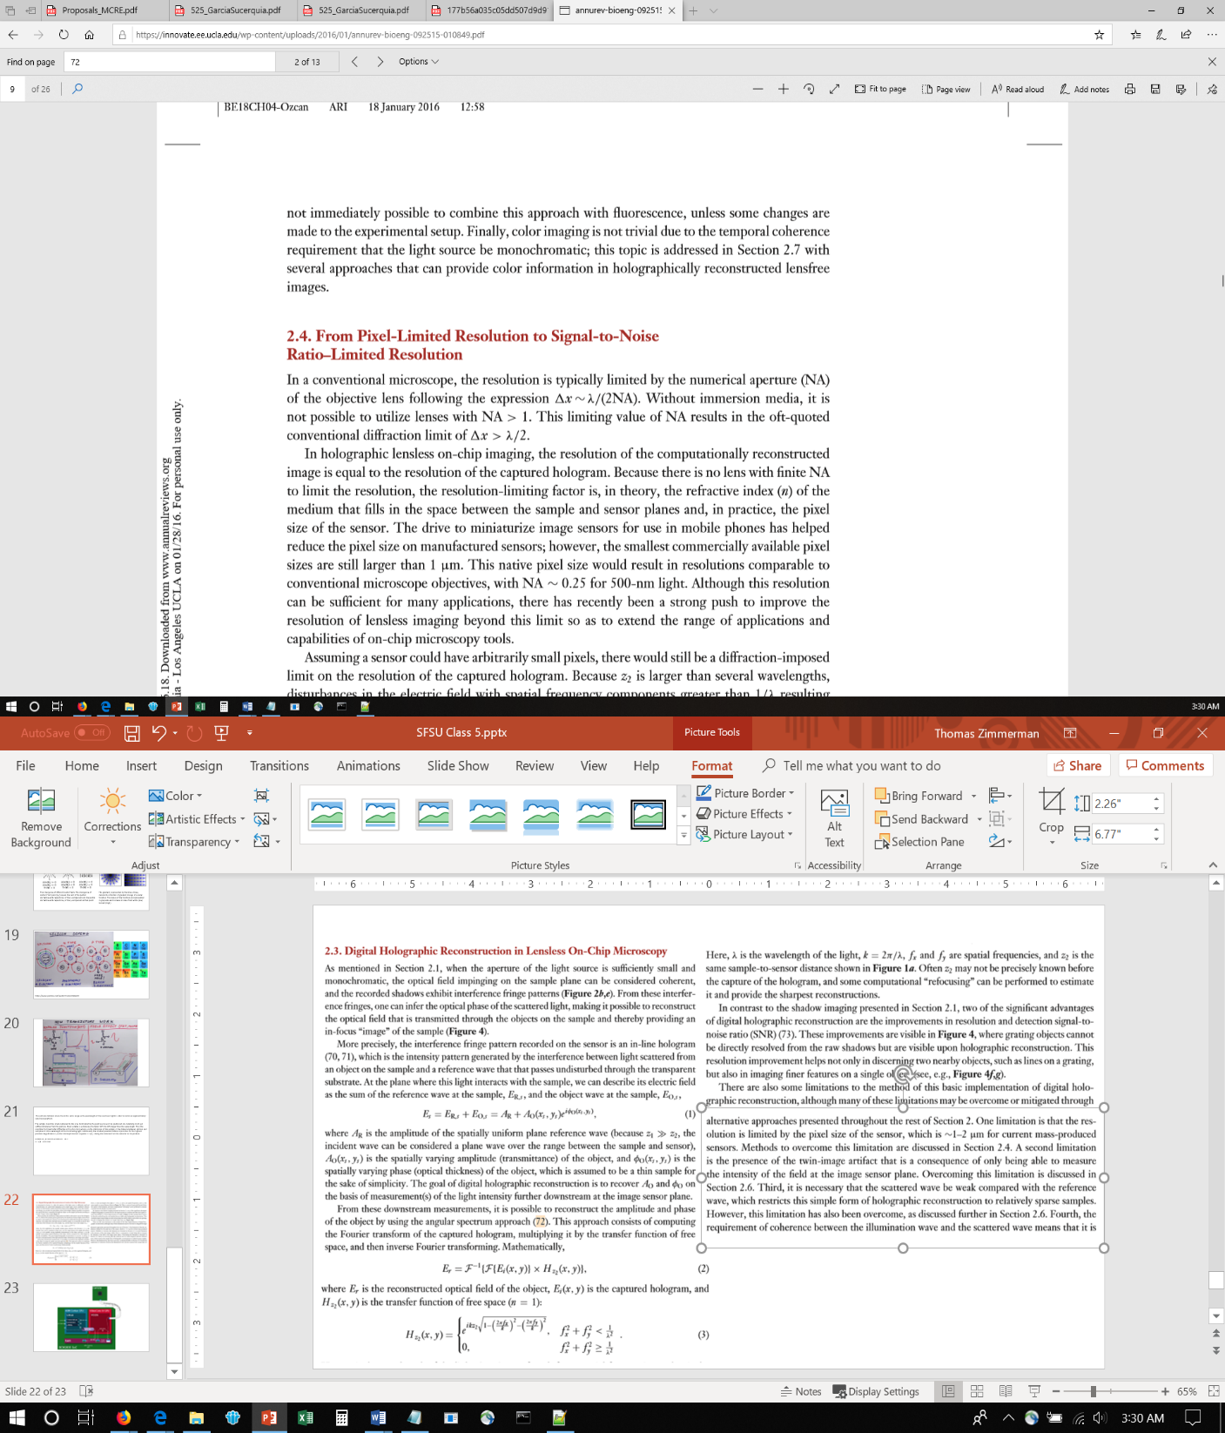
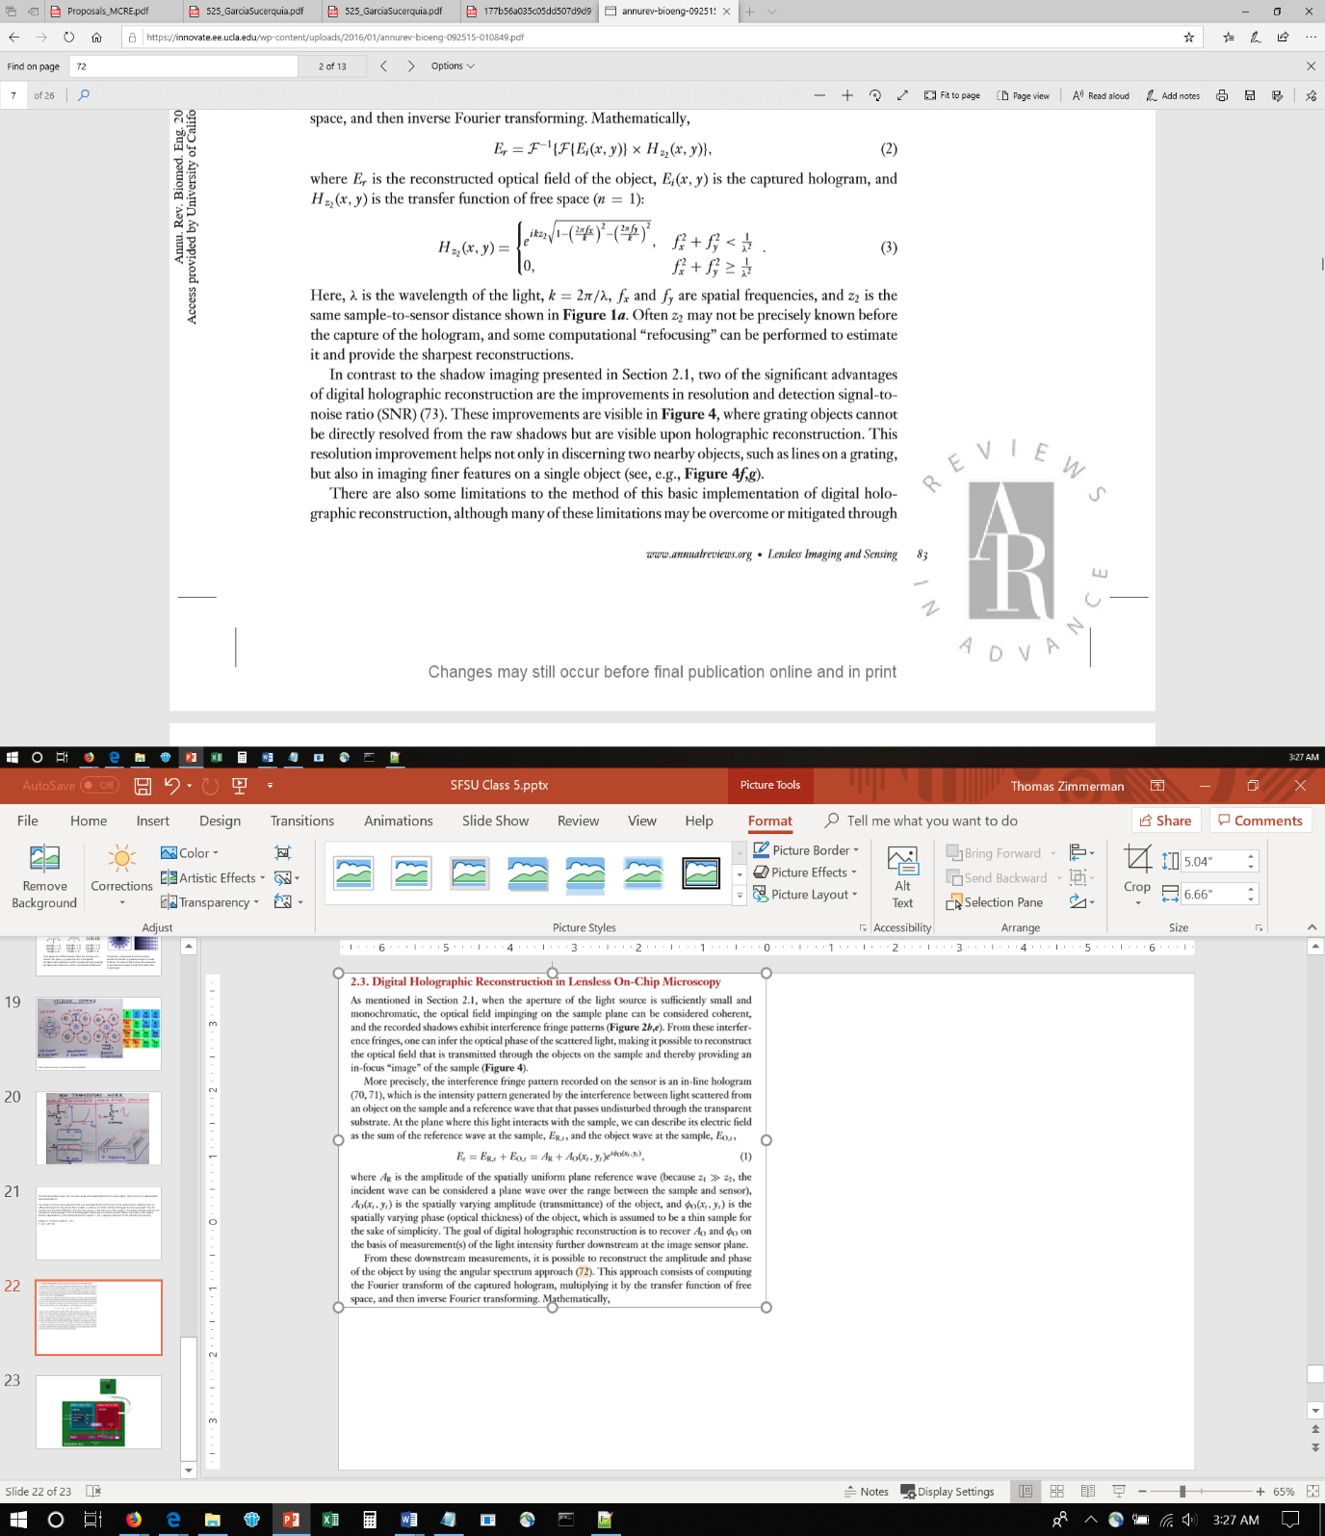
https://innovate.ee.ucla.edu/wp-content/uploads/2016/01/annurev-bioeng-092515-010849.pdf

Slide 23
